Slide 1
Level 5 Coaching QR Codes

Slide 2
Workshop 1

Slide 3
Workshop 2

Slide 4
Workshop 3

Slide 5
Workshop 4

Slide 6
Workshop 5

Slide 7
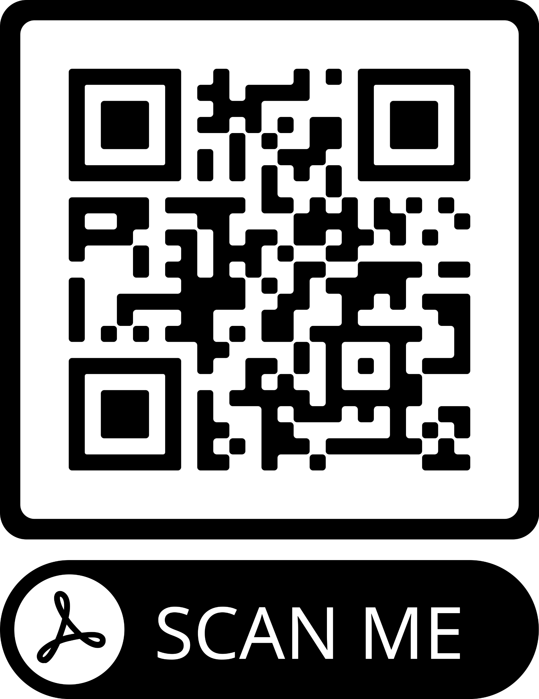
Workshop 6

Slide 8
Workshop 7

Slide 9
Workshop 8

Slide 10
Coaching Mentoring Factsheet

Slide 11
Powerful Coaching Questions

Slide 12
GROW Questioning Funnel

Slide 13
Does Coaching Work

Slide 14
Research (Carter and Miller)

Slide 15
CIPD Research

Slide 16
Global Code of Ethics

Slide 17
ICF Core Competencies

Slide 18
EMCC Contracting Guidance

Slide 19
ICF Sample Coaching Agreement

Slide 20
CIPD 2021 Learning Skills Work Report

Slide 21
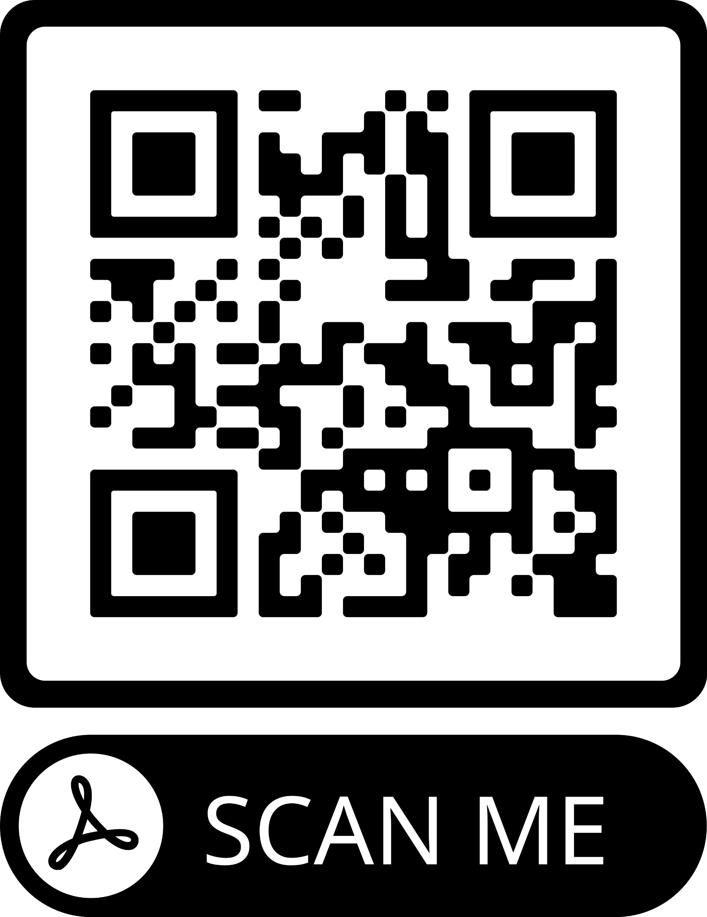
Practical Methods for Evaluating Coaching

Slide 22
SWOT Coaching Questions

Slide 23
Wheel of Life Template

Slide 24
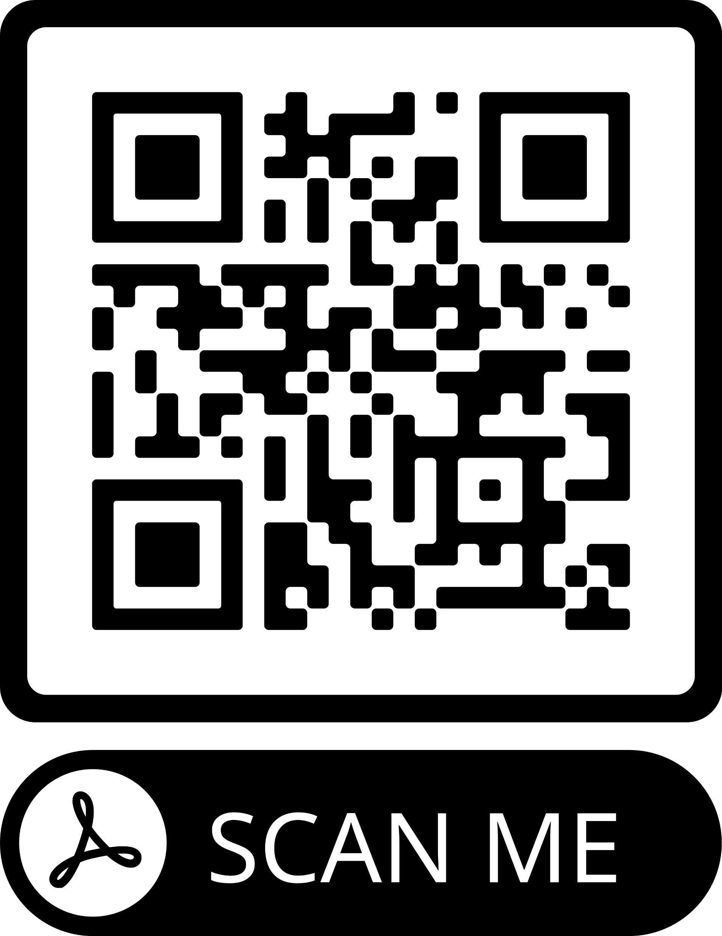
ICF Final Report

Slide 25
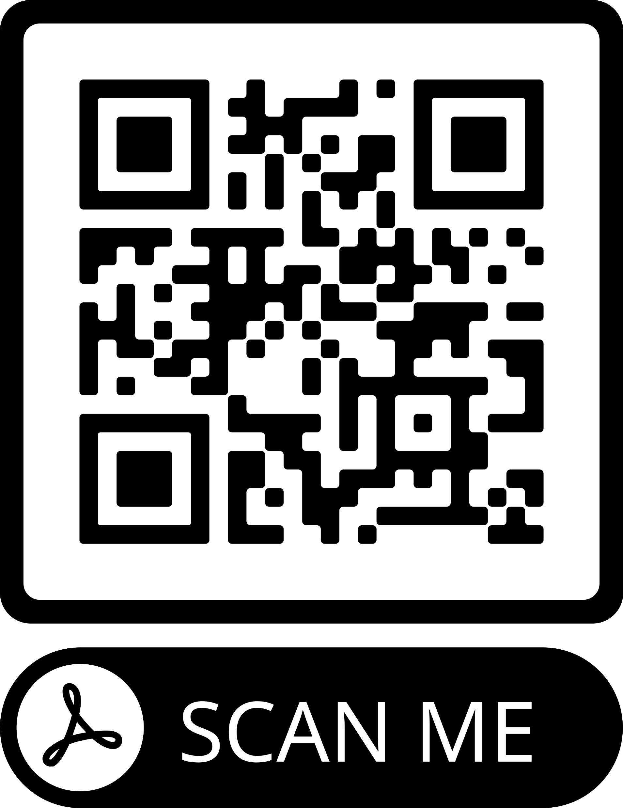
What Makes a Coach Effective (Alison Carter)

Slide 26
ICF Core Competencies

Slide 27
EMCC Competence Framework

Slide 28
Scaling Tool

Slide 29
Visual, Verbal, Vocal

Slide 30
ICF Global Code of Ethics

Slide 31
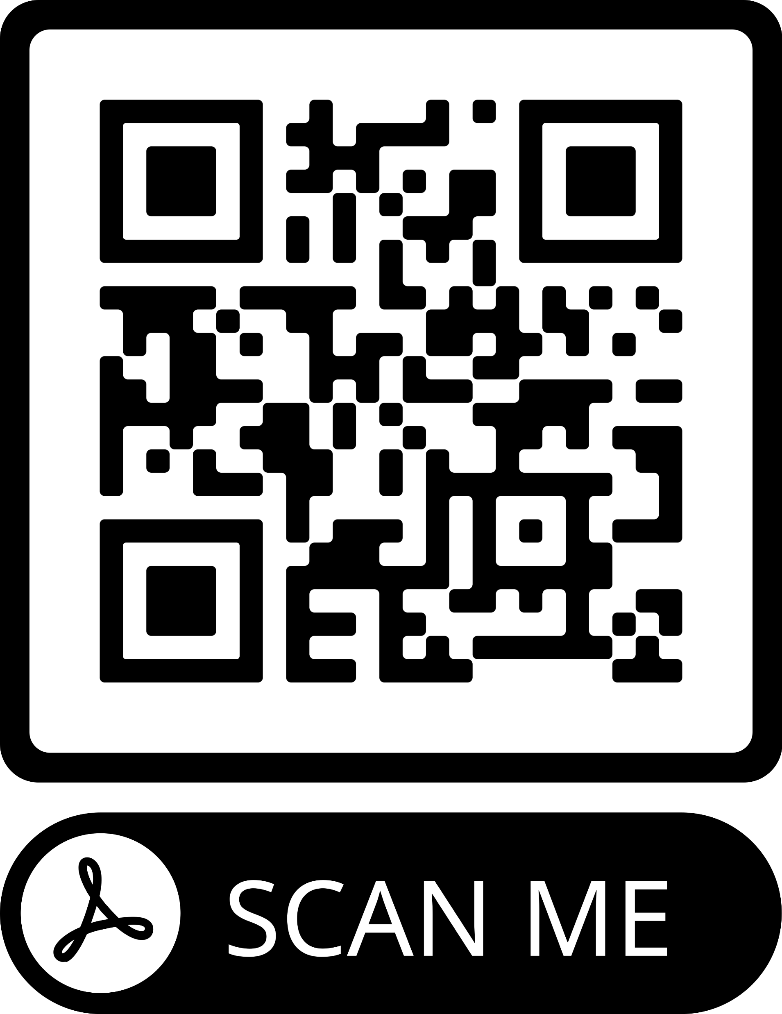
Global Code of Ethics

Slide 32
Coaching Session Reflective Log

Slide 33
The Coaching Feedback Model

